Slide 1
The Amazing Group Jans’ Food Place
ADemir Gotov
Jan Chau
Sumanth Yerra
Ryan Alcorn
CPAN-255 Design Patterns & Software Testing

Slide 2
Design Patterns we Used
Builder
Decorator
Façade
Factory
Template

Slide 3
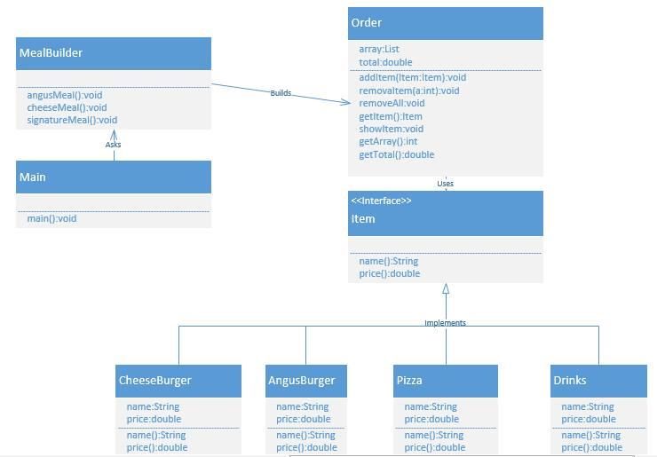
Builder Design Pattern

Slide 4
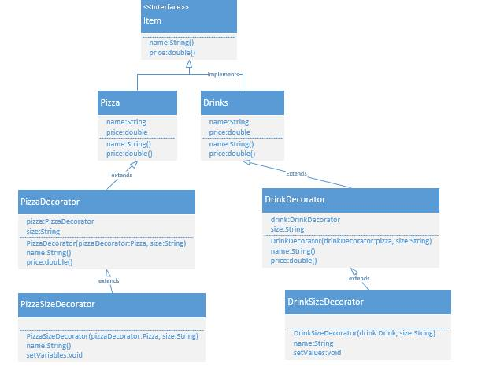
Decorator Design Pattern

Slide 5
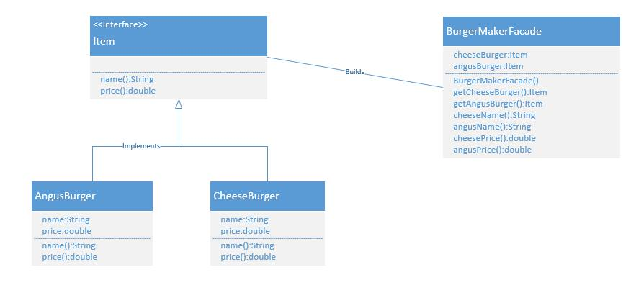
Façade Design Pattern

Slide 6
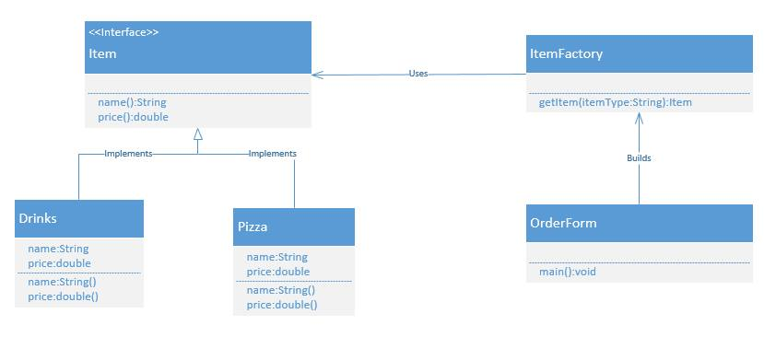
Factory Design Pattern

Slide 7
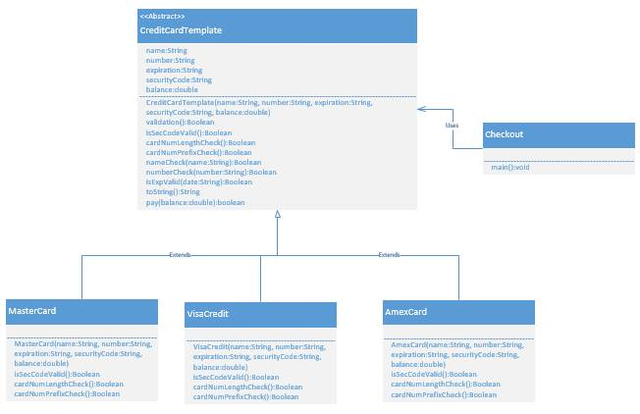
Template Design Pattern

Slide 8
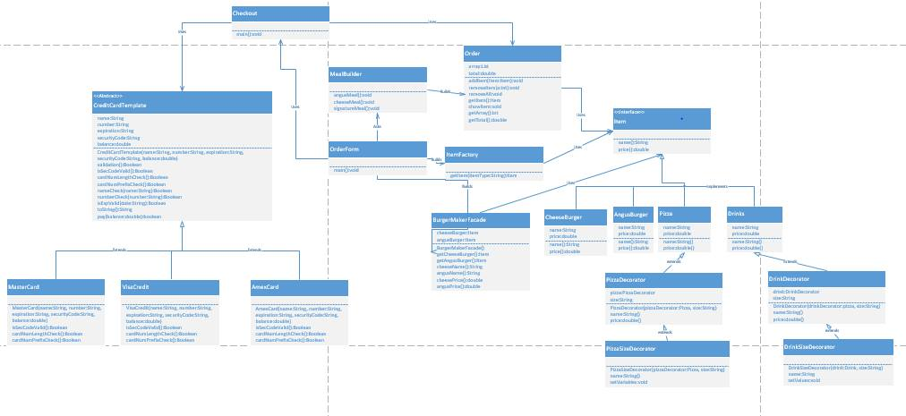
Project Class Diagram

